Slide 1

UNIVERSITY INSTITUTE OF SCIENCES
Academic Unit V
Bachelor of Engineering
(Computer Science & Engineering)
Biology For Engineers
23SZT-148
Nervous System
DISCOVER . LEARN . EMPOWER

Slide 2
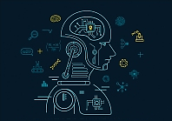

Course Outcome
CO Number | Title | Level
CO1 | Identify the biological concepts from an engineering perspective. | Remember
CO2 | Development of artificial systems mimicking human action. | Understand
CO3 | Explain the basic of genetics that helps to identify and formulate problems | Understand
CO4 | Apply knowledge of measurement system, biomedical recording system and biosensors to excel in areas such as entrepreneurship, medicine, government, and education. | Understand
CO5 | Integrate biological principles for developing next generation technologies
Will be covered in this lecture
https://images.app.goo.gl/5obqqxo93P2UBmdU6

Slide 3
SYLLABUS
Unit-2 | Biosensors and measurement system | Contact Hours: 15
Chapter 1 Medical Instrumentation Chapter 2 Measurement System Chapter 3 Biological Sensor | Medical Instrumentation: Sources of biomedical Signals, Basic medical Instrumentation system, Performance requirements of medical Instrumentation System, Microprocessors in Medical instruments, PC base medical Instruments, General constraints in the design of medical Instrumentation system, Regulation of Medical Devices. Measurement System: Specification of instruments, Statics & Dynamic characteristics of medical instruments, Classification of errors. Statistical analysis, Reliability, Accuracy, Fidelity, Speed of responses, Linearization of technique, and Data Acquisition System. Biological sensors: Sensors/ receptors in the human body, basic organization of the nervous system- neural mechanism, Chemoreceptor: hot and cold receptors, sensors for smell, sound, vision, Ion exchange membrane electrodes, enzyme, glucose sensors, immunosensors, & biosensors & applications of biosensors.

Slide 4
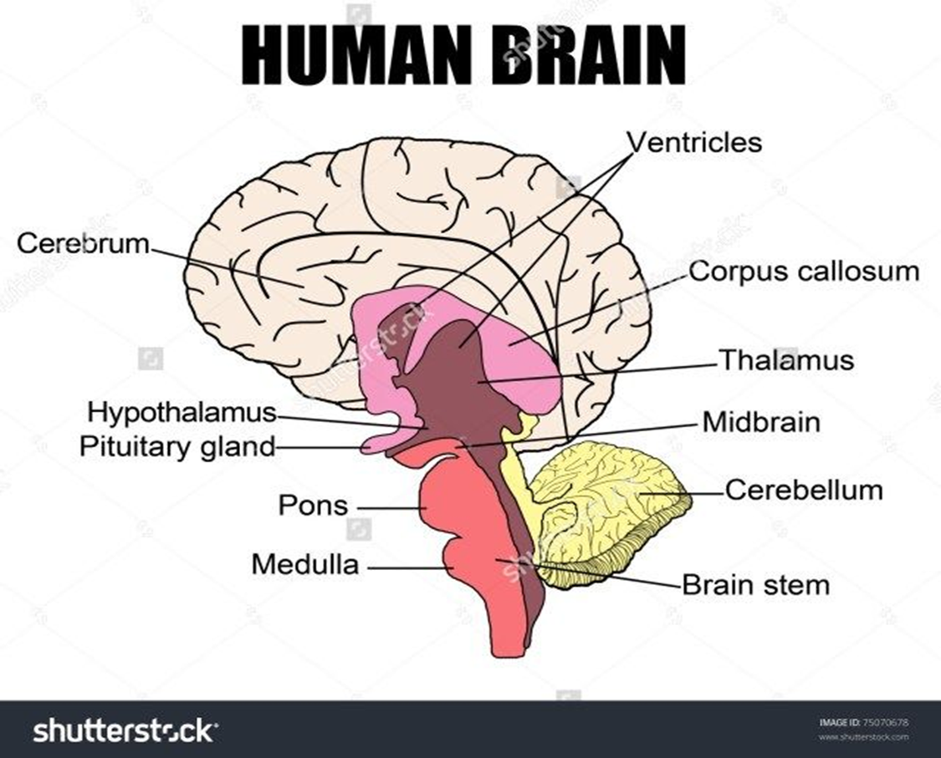
Nervous System

Slide 5
Nervous System
The nervous system is a network of neurons whose main feature is to generate, modulate and transmit information between all the different parts of the human body.
This property enables many important functions of the nervous system, such as regulation of vital body functions (heartbeat, breathing, digestion), sensation and body movements.
Ultimately, the nervous system structures preside over everything that makes us human; our consciousness, cognition, behaviour and memories.

Slide 6
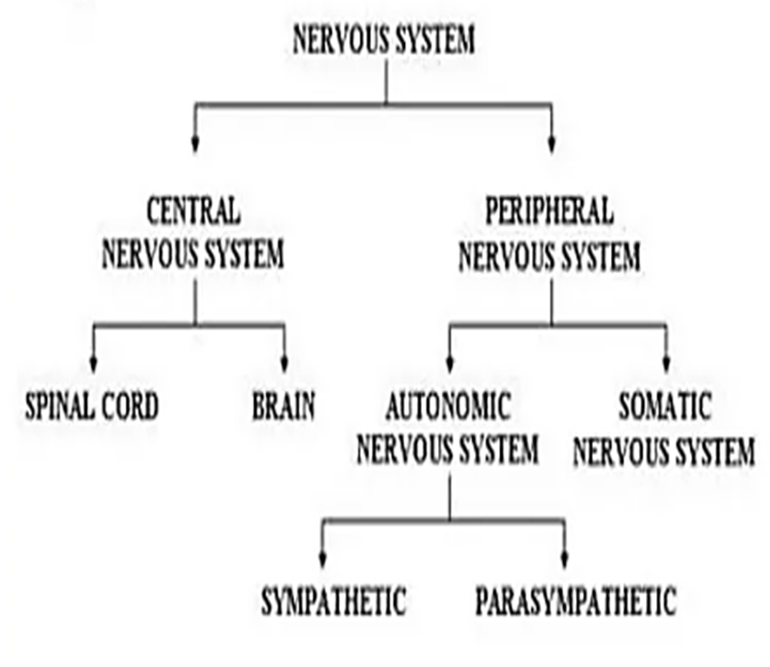

Slide 7
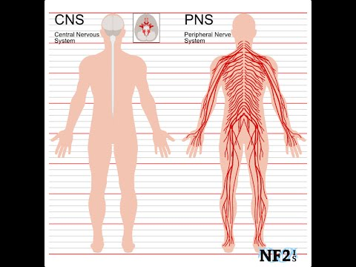
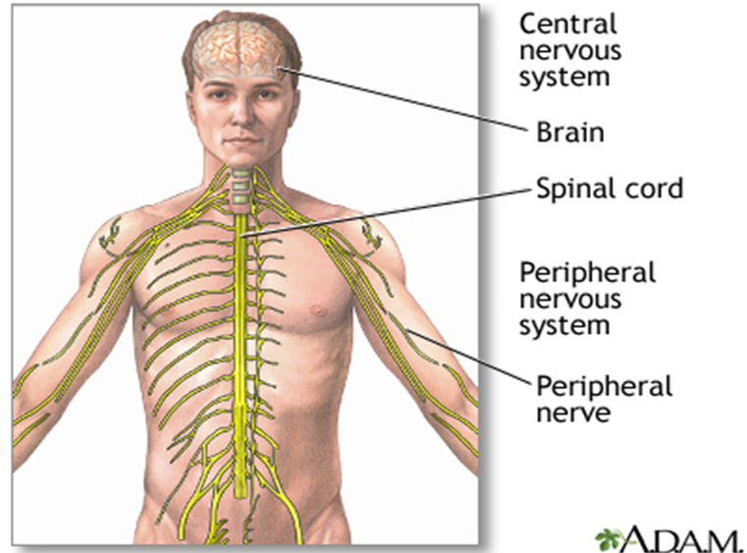

Slide 8
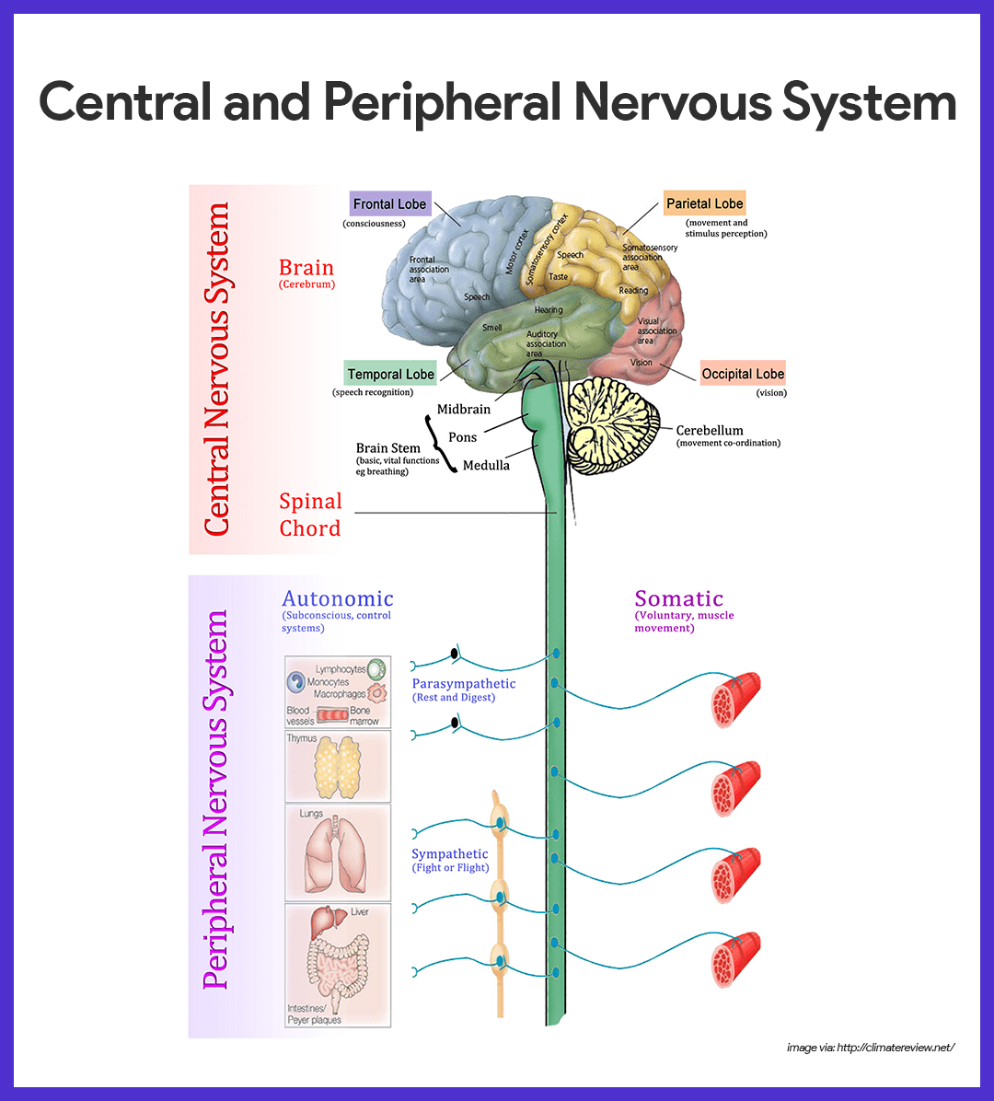

Slide 9
A. Central Nervous System: Brain and Spinal Cord
The central nervous system (CNS) consists of the brain and spinal cord.
These are found housed within the skull and vertebral column respectively.
Together these parts process the incoming information from peripheral tissues and generate commands; telling the tissues how to respond and function.
These commands tackle the most complex voluntary and involuntary human body functions, from breathing to thinking.

Slide 10
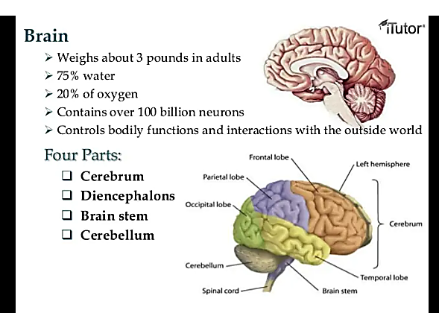
1. Brain
Brain is the largest and most complex mass of nervous tissue in the body.
Weighs about 3 pounds in adults
75% water
20% of oxygen
Contains over 100 billion neurons
Controls bodily functions and interactions with the outside world.

Slide 11
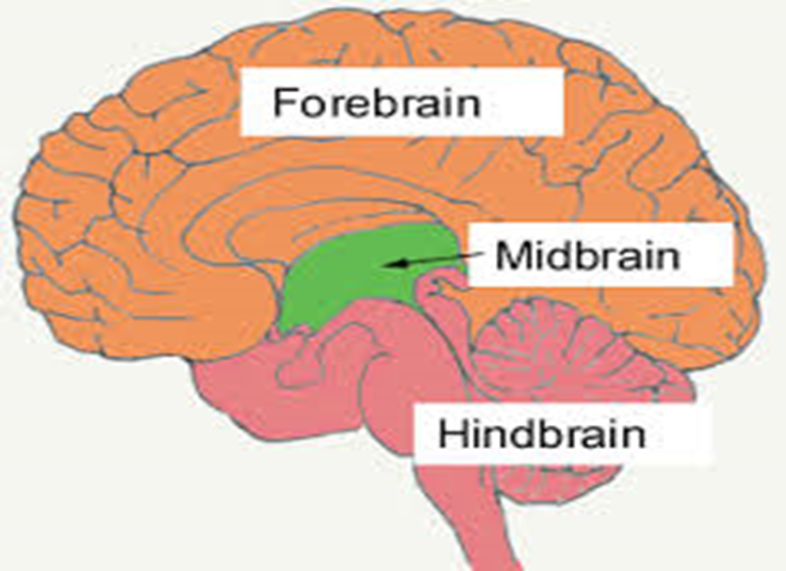
Parts of the human brain
The human brain is made up different parts and compartments, for each of the functions. Take a look at the different parts of the brain.
Forebrain
Midbrain
Hind Brain

Slide 12

Forebrain
It is the main thinking part of the brain and controls the voluntary actions.
The forebrain processes sensory information that is collected from the various sense organs such as ears, eyes, nose, tongue, skin.
It is because of the presence of forebrain, humans are placed at the highest level in the animal chain.
The forebrain consists of the Cerebrum, Thalamus and Hypothalamus.

Slide 13
Cerebrum
The cerebrum is the biggest part of the brain.
This part we associate with higher brain functions such as thinking and action.
The cerebrum is divided into two halves by a deep furrow. These halves are the left and right hemispheres. Each side functions slightly different from the other, even though they are symmetrical. So the right hemisphere links to creativity whereas the left hemisphere relates to logic abilities. And Corpus callosum connects the two hemispheres.
It is divided into four sections, called “lobes”. They are; the frontal lobe, the parietal lobe, the occipital lobe and the temporal lobe

Slide 14
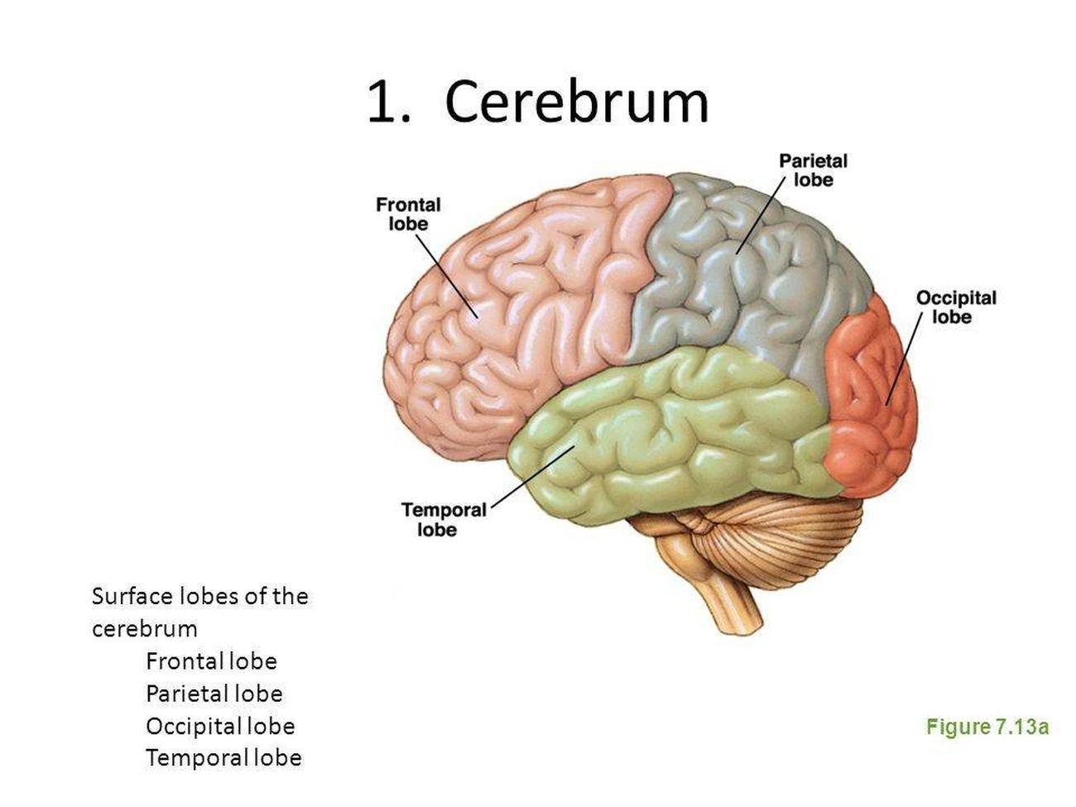
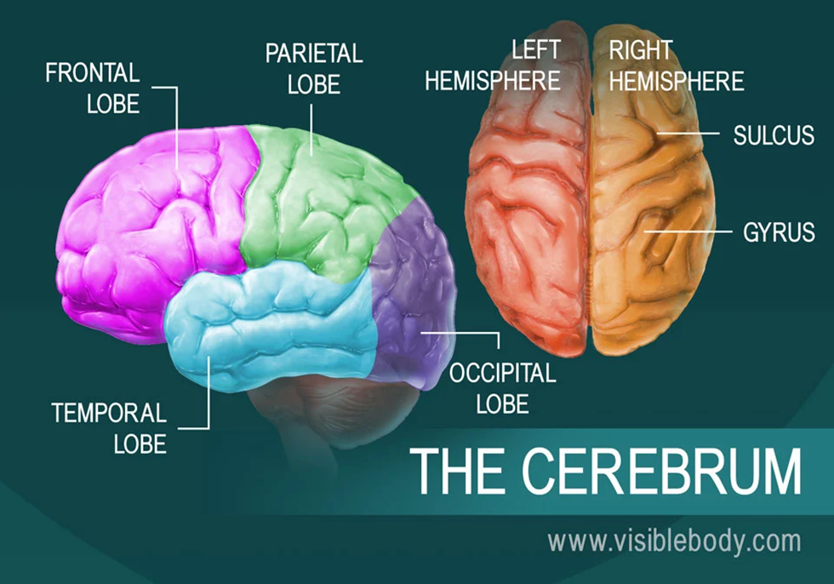

Slide 15

Frontal Lobe
The frontal lobe lies just beneath our forehead and is associated with our brain’s ability to reason, organize, plan, speak, move, make facial expressions, serial task, problem solve, control inhibition, initiate and self-regulate behaviors, pay attention, remember and control emotions.

Slide 16

Parietal Lobe
The parietal lobe is located at the upper rear of our brain, and controls our complex behaviors, including senses such as vision, touch, body awareness and spatial orientation.
It plays important roles in integrating sensory information from various parts of our body, knowledge of numbers and their relations, and in the manipulation of objects.
Portions are involved with our visuospatial processing, language comprehension, the ability to construct, body positioning and movement, left-right differentiation and self-awareness.

Slide 17
Occipital Lobe
The occipital lobe is located at the back of our brain, and is associated with our visual processing, such as visual recognition, visual attention, spatial analysis (moving in a 3-D world) and visual perception of body language; such as postures, expressions and gestures.

Slide 18
Temporal Lobe
The temporal lobe is located near our ears, and is associated with processing our perception and recognition of auditory stimuli (including our ability to focus on one sound among many, like listening to one voice among many at a party), comprehending spoken language, verbal memory, visual memory and language production (including fluency and word-finding), general knowledge and autobiographical memories.

Slide 19
Thalamus and hypothalamus
Thalamus – the primary role of the thalamus is to relay sensory information from other parts of the brain to the cerebral cortex.
The hypothalamus is a small region of the brain. It’s located at the base of the brain, near the pituitary gland. While it’s very small, the hypothalamus plays a crucial role in many important functions, including:
releasing hormones
regulating body temperature
maintaining daily physiological cycles
controlling appetite
managing of sexual behavior
regulating emotional responses

Slide 20
Mid Brain
The midbrain connects the forebrain and the hindbrain. It acts as a bridge and transmits signals from hindbrain and forebrain. It is associated with motor control, vision, hearing, temperature regulation, alertness.

Slide 21
Hind Brain
It is the control centre for visceral function. As a result, this part of the brain plays a role in controlling the heart rate, breathing, blood pressure, sleep and waking up functions etc.
The hindbrain has three parts, namely –
cerebellum.
medulla oblongata,
pons

Slide 22
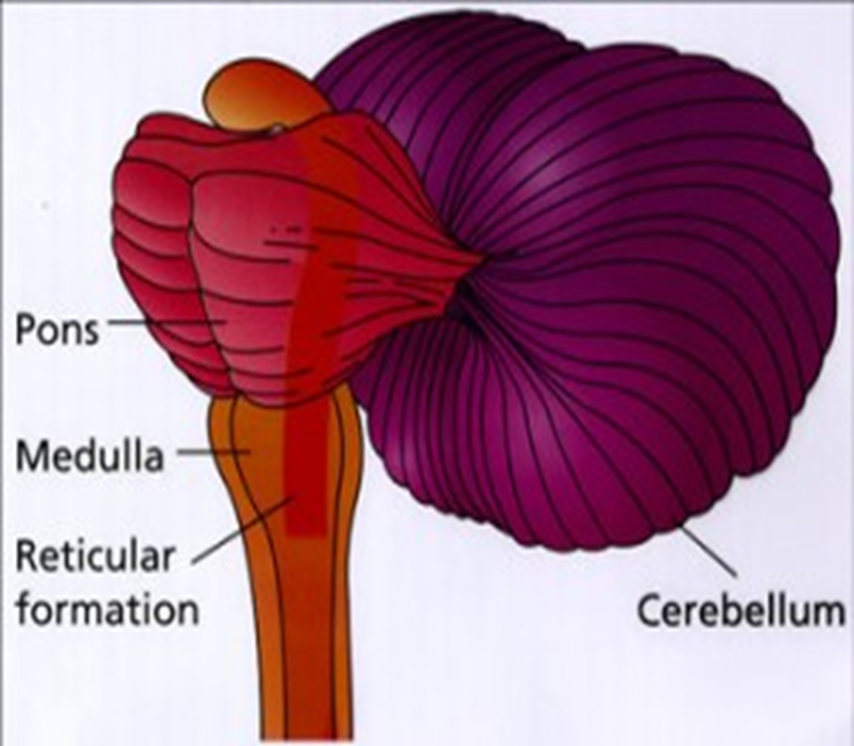
Cerebellum
The cerebellum is responsible for maintaining equilibrium, transfer of information, fine adjustments to motor actions, coordinating eye movements etc. Coordination and body balance, posture during walking, riding, standing, swimming, running, are all maintained by the cerebellum.

Slide 23

Medulla oblongata
The primary role of the medulla is regulating our involuntary life sustaining functions such as breathing, swallowing and heart rate. As part of the brain stem, it also helps transfer neural messages to and from the brain and spinal cord. It is located at the junction of the spinal cord and brain.

Slide 24

Pons
The primary role of the pons is to serve as a bridge between various parts of the nervous system, including the cerebellum and cerebrum. Many important nerves that originate in the pons, such as the trigeminal nerve, responsible for feeling in the face, as well as controlling the muscles that are responsible for biting, chewing, and swallowing.

Slide 25
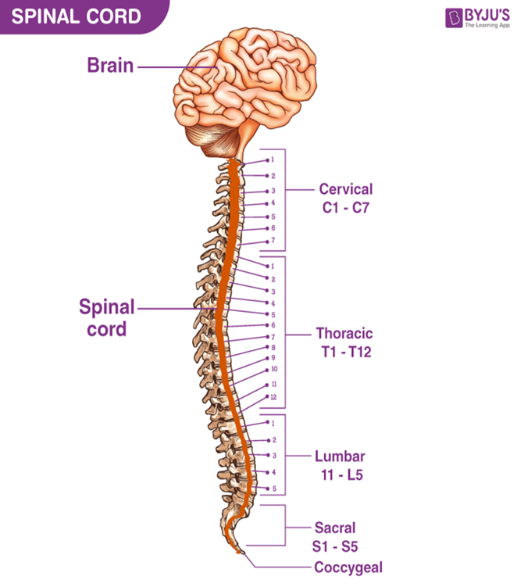
2. The spinal cord
The spinal cord is part of the central nervous system (CNS). It is situated inside the vertebral canal of the vertebral column.
Like the vertebral column, the spinal cord is divided into segments: cervical, thoracic, lumbar, sacral, and coccygeal. Each segment of the spinal cord provides several pairs of spinal nerves, which exit from vertebral canal

Slide 26
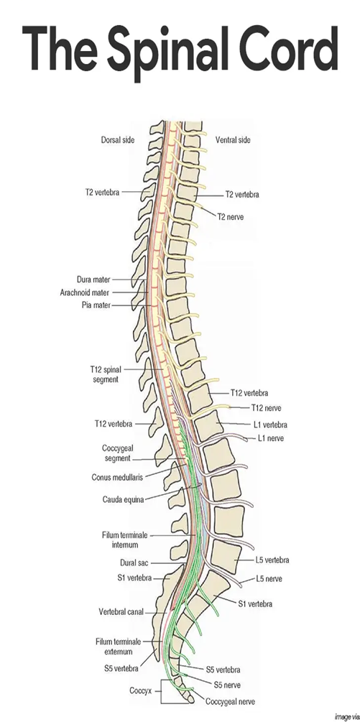
There are 8 pairs of cervical, 12 thoracic, 5 lumbar, 5 sacral, and 1 coccygeal pair of spinal nerves (a total of 31 pairs).

Slide 27
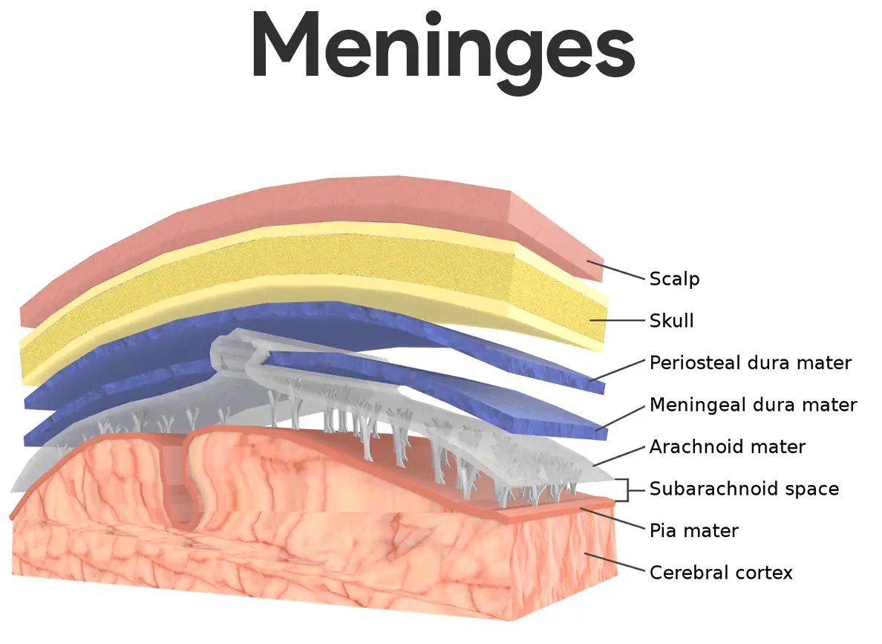
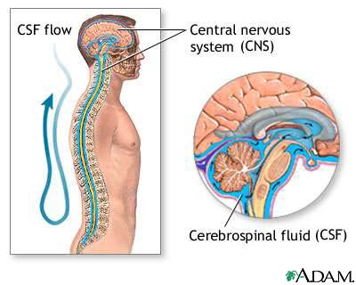
Protection of the Central Nervous System
Nervous tissue is very soft and delicate, and the irreplaceable neurons can be injured or destroyed by even the slightest pressure.
So nature has tried to protect the brain and the spinal cord by:
Enclosing them within bones
For Brain : The skull
For Spinal Cord: vertebral column
Surrounding membranes called meninges: The three connective tissue membranes covering and protecting the CNS structures
A watery cushion (cerebrospinal fluid): It cushions the brain and cord from shocks that could cause injury

Slide 28
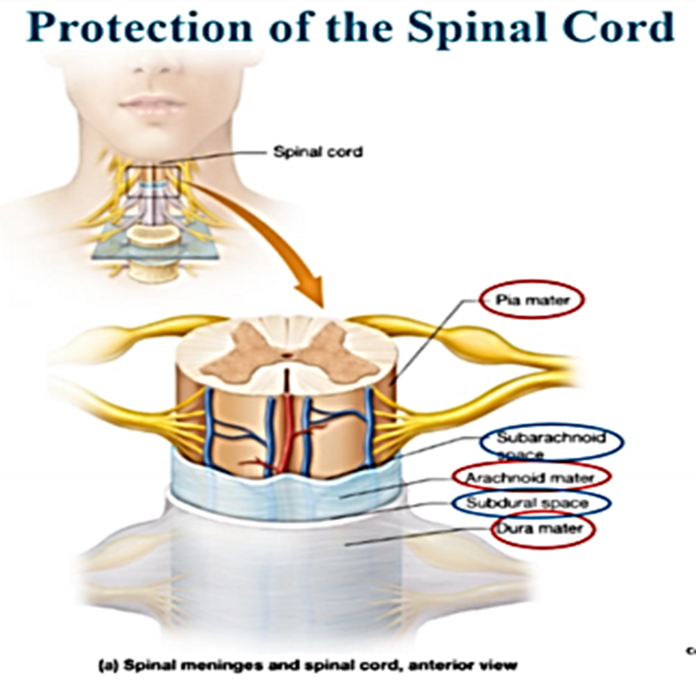
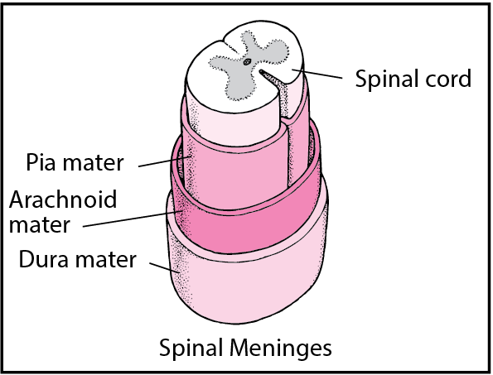
Spinal Cord
Extends from the medulla oblongata of the brain to the area around the first lumbar vertebra in the lower back.
Nerves from the peripheral nervous system extend out from the spinal cord.
Protected by:
Vertebral column
Cerebrospinal fluid (CSF)
Meninges

Slide 29
Meninges
Meninges are three layers of membranes that cover the brain and spinal cord.
Layers of the meninges
Dura mater
Outer tough fibrous membrane
Arachnoid mater
Middle weblike membrane containing CSF
Space between Dura mater and Arachnoid mater is called Subdural space which is filled with cerebrospinal fluid (CSF)
Pia mater
Innermost layer containing several blood vessels

Slide 30
B. The peripheral nervous system
The peripheral nervous system (PNS) consists of all the nerves branching out of the brain and spinal cord (the central nervous system, CNS).
If you imagine the CNS as the main highway, then the PNS forms all the connecting secondary roads.
These allow electrical impulses to travel to and from the furthest regions, or periphery, of the human body.

Slide 31
The PNS is built almost entirely from nerves. There are two main types; spinal nerves and cranial nerves.
Functionally, the PNS can be divided into the autonomic and somatic nervous systems. Both of these can be further subdivided; the former into sympathetic and parasympathetic arms and the latter into sensory and motor divisions.

Slide 32
Cranial Nerves
S. No. | Cranial Nerves | Function
1 | Olfactory | Sense of smell
2 | Optic | Sense of vision
3 | Oculomotor | Eye movements
4 | Trochlear | Aids muscles that move the eyes
5 | Trigeminal | Eyes, tear glands, scalp, forehead, teeth, gums, lips and mouth muscles
6 | Abducens | Muscle conditioning
7 | Facial | Taste, facial expressions, tear and salivary glands
8 | Vestibulocochlear | Hearing and equilibrium
9 | Glossopharyngeal | Pharynx, tonsils tongue and carotid arteries; stimulates salivary glands
10 | Vagus | Speech, swallowing, heart muscle, smooth muscle and certain glands
11 | Accessory | Muscles of the soft palate, pharynx, larynx and neck
12 | Hypoglossal | Tongue movement
Cranial nerves are peripheral nerves that emerge from the cranial nerve nuclei of the brainstem and spinal cord.
They innervate the head and neck.
Cranial nerves are numbered one to twelve according to their order of exit through the skull fissures

Slide 33
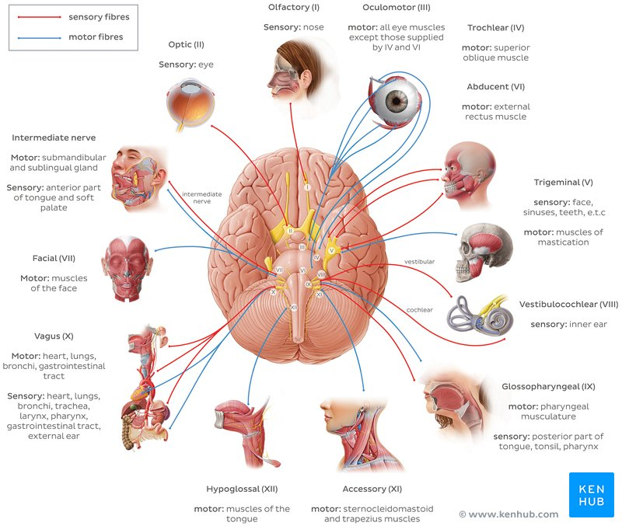

Slide 34
Spinal nerves
The second set of peripheral nerves are spinal nerves, of which there are 31 pairs: eight cervical, twelve thoracic, five lumbar, five sacral, and one coccygeal. Their numbering relates to the vertebral column exit level; cervical spinal nerves are numbered according to the vertebra located below, while all the rest according to the vertebra situated above.

Slide 35
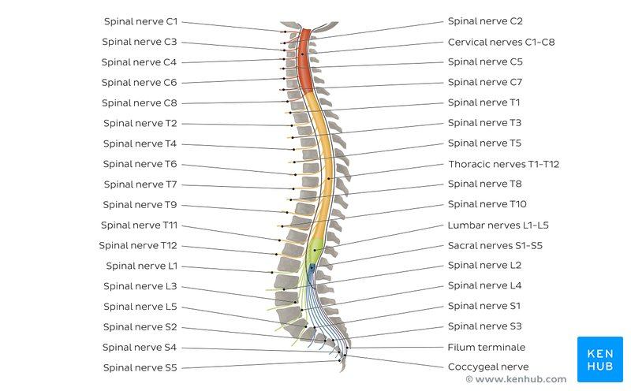

Slide 36
AUTONOMIC NERVOUS SYSTEM
The autonomic nervous system is the part of the nervous system that supplies the internal organs, including the blood vessels, stomach, intestine, liver, kidneys, bladder, genitals, lungs, pupils, heart, and sweat, salivary, and digestive glands.
The autonomic nervous system has two main divisions:
Sympathetic
Parasympathetic

Slide 37
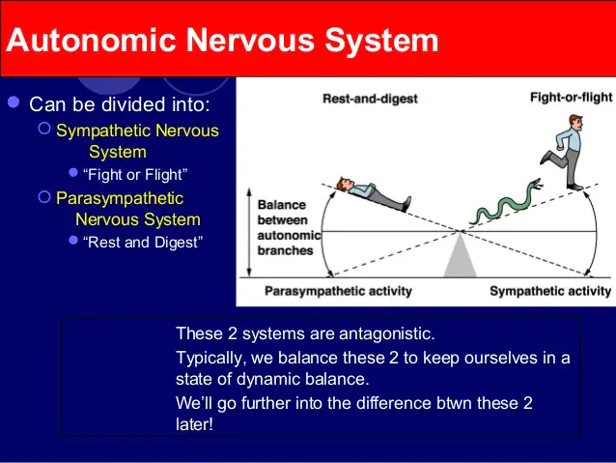
Autonomic Nervous System Subdivisions
Sympathetic
Responsible for adjusting our bodies for situations of increased physical activity
Its actions are commonly described as the ‘Fight or Flight’ response.
As it stimulates responses such as faster breathing, increased heart rate, elevated blood pressure, dilated pupils and redirection of blood flow from the skin, kidneys, stomach and intestines to the heart and muscles, where it’s needed.
Parasympathetic
Responsible for adjusting our bodies for energy conservation, activating “rest and digest” activities.
The nerves of the PSNS slow down the actions of the cardiovascular system, divert blood away from muscles and increase peristalsis and gland secretion.

Slide 38
Function of the autonomic nervous system
The autonomic nervous system controls internal body processes such as the following:
Blood pressure
Heart and breathing rates
Body temperature
Digestion
Metabolism (thus affecting body weight)
The balance of water and electrolytes (such as sodium and calcium)
The production of body fluids (saliva, sweat, and tears)
Urination
Defecation
Sexual response

Slide 39
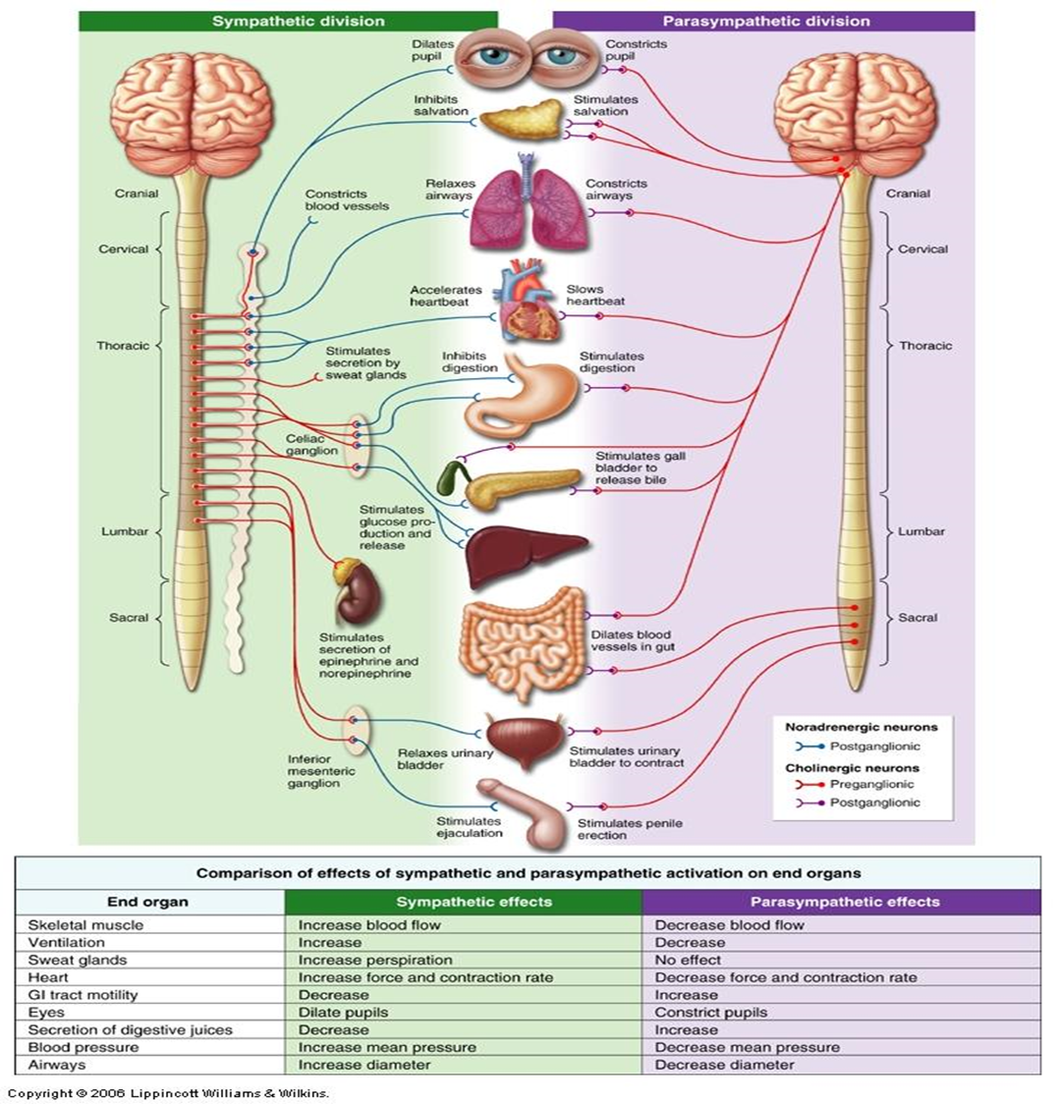

Slide 40
Somatic nervous system
The somatic nervous system is a component of the peripheral nervous system associated with the voluntary control of the body movements via the use of skeletal muscles.
Striated skeletal muscles under voluntary control receive signals to contract on the basis of stimuli relayed to the CNS.

Slide 41
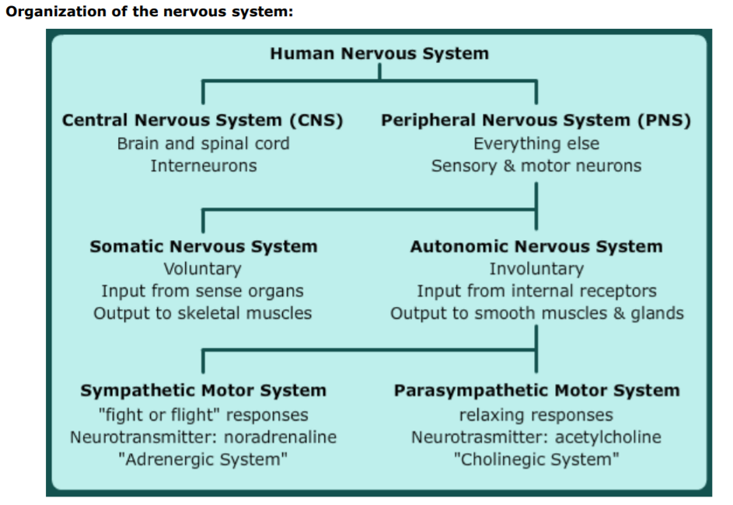

Slide 42
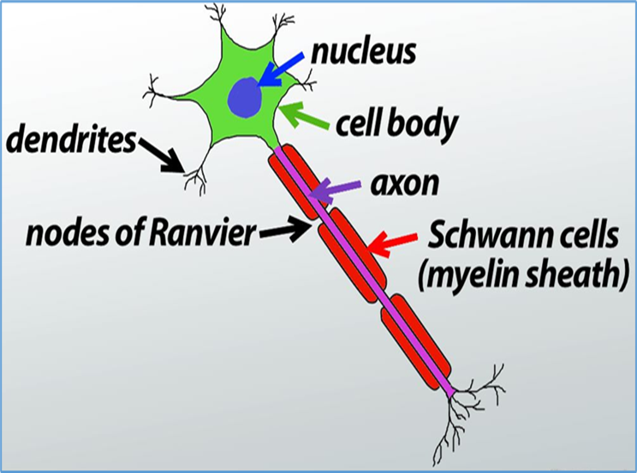
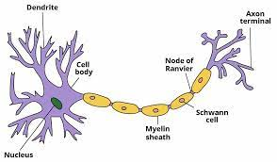
Neurons
A neuron is a structural and functional unit of the neural tissue and hence the neural system.
Certain neurons may almost equal the length of body itself.
Thus neurons with longer processes (projections) are the longest cells in the body.
Human neural system has about 100 billion neurons.

Slide 43
Neuron
A typical neuron consists of a cell body (=Ctyton or soma), dendrites, and an axon with an axon terminal.
Cell body: (= Cyton or Soma):
It varies in size and form. It may be up to 13.5 µm in diameter and may be irregular, spherical, oval, rounded, star-shaped or pyramidal. Like a typical cell it consists of cytoplasm, nucleus and cell membrane.
It has abundant cyto­plasm, called neuroplasm and a relatively large spherical central nucleus with a distinct nucleolus.
The cytoplasm has mitochondria, Golgi apparatus, rough endoplasmic reticulum, ribosomes, lysosomes, fat globules, pigment granules, neurofibrils, neurotubules and Nissl’s granules.
The Nissl’s granules (also called Nissl’s bodies) are irregular masses of rough endoplasmic reticulum with numerous attached and free ribosomes. The Nissl’s granules probably synthesize proteins for the cell.

Slide 44
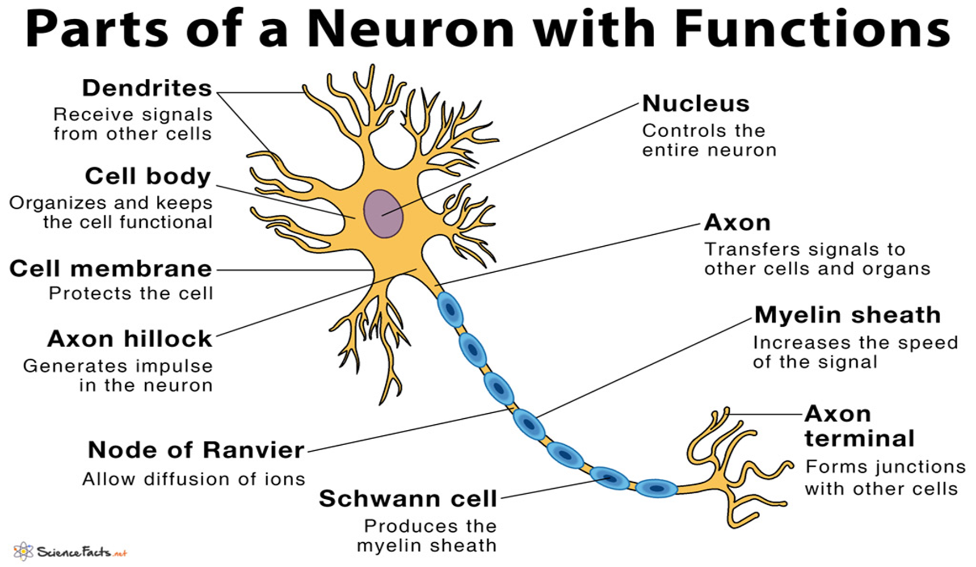
(ii) Neurites:
The processes of neurons are called neurites. These are of two types: dendrites or dendrons and an axon or axis cylinder or neuraxon.
(a) Dendrites (Dendrons):
These are usually shorter, tapering and much branched processes. They may be one to several. The dendrites contain neurofibrils, neurotubules and Nissl’s granules. They conduct nerve impulse towards the cell body and are called afferent processes (= receiving processes).

Slide 45
(b) Axon:
Axon is a single, usually very long process of uniform thickness. The part of cyton from where the axon arises is called axon hillock. Most sensitive part of neuron is axon hillock. The axon contains neurofibrils and neurotubules but does not have Nissl’s granules, Golgi complex, ribosomes, pigment granules, fat globules, etc.

Slide 46
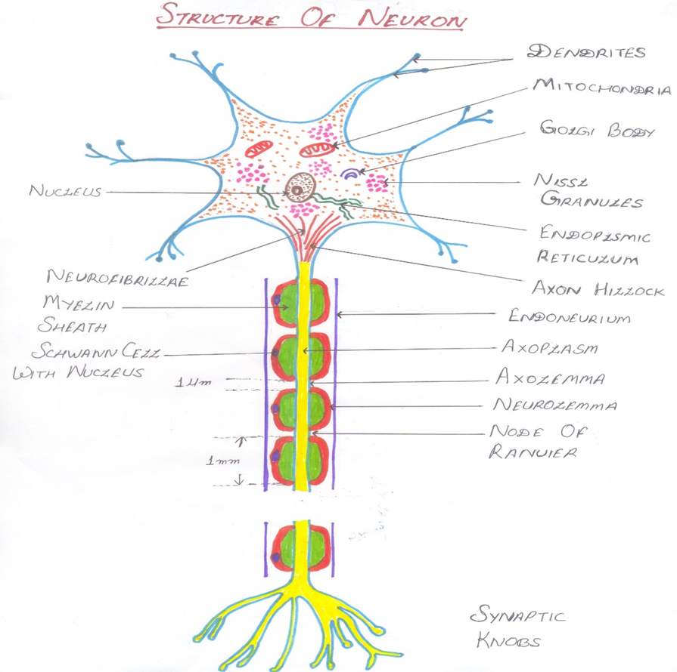
In the absence of Nissl’s granules, the axon depends on the cell body for the supply of proteins. The cell membrane of the axon is called axolemma and its cytoplasm is known as axoplasm. The axon ends in a group of branches, the terminal arborizations (= axon terminals).

Slide 47
When terminal arborizations of the axon meet the dendrites of another neuron to form a synapse they form synaptic knobs (= end plates). The synaptic knobs contain mitochondria and secretory vesicles. The part of the sarcolemma (muscle plasma membrane) that lies beneath the axon terminals/nerve endings, is called motor end plate.
Each axon may also possess side branches called collateral fibres which are usually much finer than the main axonal process. The axon conducts nerve impulses away from the cell body, therefore, called an efferent process.

Slide 48
There are two types of axon namely myelinated and non-myelinated. In myelinated nerve fibres, Schwann cells form myelin sheath around the axon. The gaps between two adjacent myelin sheaths are called nodes of Ranvier.
Myelin sheath provides protective insulation for your nerve cell and allows electrical impulses to transmit quickly and efficiently along the nerve cells.
Myelinated nerve fibres are found in cranial and spinal nerves.
In non-myelinated nerve fibres, Schwann cells do not form myelin sheath and are without nodes of Ranvier.

Slide 49
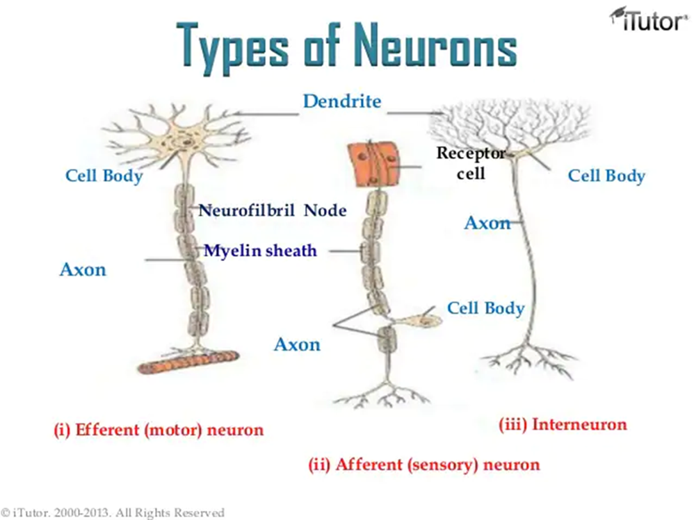
Types of Neurons
Efferent (Motor neurons): Transmit messages from the central nervous system to the muscles (or to glands)
Afferent (Sensory neurons): Carry messages from sensory receptors to the central nervous system
Interneuron: Found only in the central nervous system where they connect neuron to neuron

Slide 50
How do neurons function?
The morphology of neurons makes them highly specialized to work with neural impulses; they generate, receive and send these impulses onto other neurons and non-neural tissues.
The site where an axon connects to another cell to pass the neural impulse is called a synapse.
The synapse doesn't connect to the next cell directly.
Instead, the impulse triggers the release of chemicals called neurotransmitters from the very end of an axon.
These neurotransmitters bind to the effector cell’s membrane, causing biochemical events to occur within that cell according to the orders sent by the CNS.

Slide 51
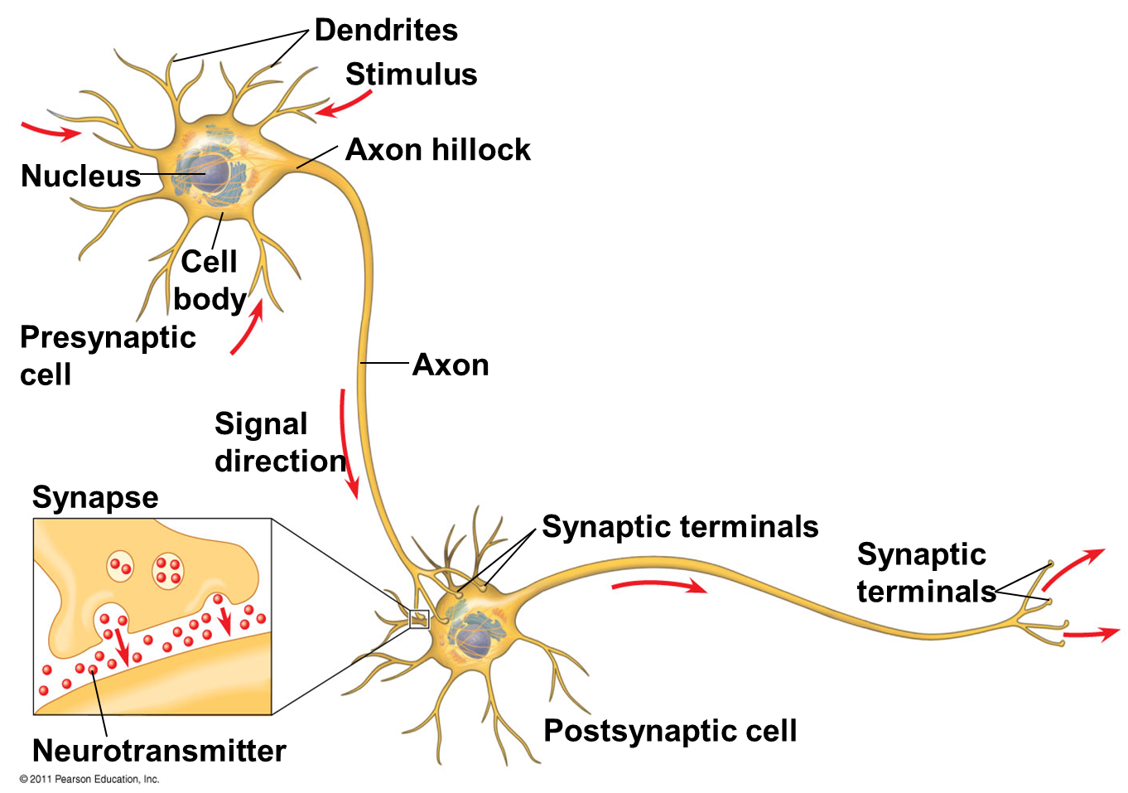

Slide 52
Reflex action
Reflex action is a rapid, automatic action carried out without the intervention of the will of the animal. It is independent of the will of the animal.
A reflex is defined as automatic/involuntary, purpose serving or goal oriented response for afferent stimulation which can be internal or external.

Slide 53
Reflex action
During reflex action the impulse travels through a path known as reflex arc.
A simple reflex arc (monosynaptic) involves a sensory or afferent neuron, an interneuron present within the spinal cord and a motor or efferent neuron.
The afferent is connected to the receptors (such as skin) and the efferent is connected to the effectors (muscles or glands).

Slide 54
Reflex action
The stimulus detected by the receptors passes into the sensory or afferent neuron.
These impulses enter the spinal cord through the dorsal root and initiate impulse in interneuron or association neuron.
From the spinal cord the impulse is carried through the ventral root and travel along the afferent or motor nerve fibres to reach the effect or organ.

Slide 55
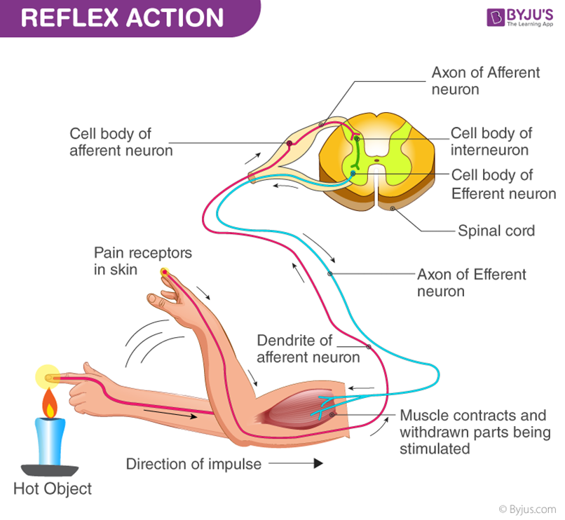
Reflex action

Slide 56
Reflex Actions
Some Important Reflex Actions:
(i) Narrowing of the pupil of eye on seeing bright light
(ii) Withdrawal of limbs when it touches hot object
Quick closing of eye lids when a flying object suddenly approaches the eye
Opening of the mouth on hearing a sudden loud noise.

Slide 57
Receptors

Slide 58
Based on the stimuli and functions, sensory receptors are classified into
Chemoreceptors: Detect presence of chemicals.
Thermoreceptors: Detect changes in the temperature.
Mechanoreceptors: Detect mechanical changes in the environment such as movements.
Photoreceptors: Detect light during vision.
Specialized sensory receptors have more specific functions. For example
Proprioceptors: Respond to positioning and movements.
Baroreceptors: Respond to changes in the blood pressure.
Hygroreceptors: Detects moisture content in the environment.
Osmoreceptors: Responds to osmotic pressure and is observed in homeothermic animals.
Sometimes the mechanism is not clear and they may exhibit multiple functions. For instance, osmoreceptors besides responding to osmolarity of fluids may also respond to mechanical and chemical changes.

Slide 59
REFERENCES
The Human Nervous System. by Juergen K. Mai (Editor), George Paxinos AO (BA MA PhD DSc) NHMRC Dr. (Editor)
The Structure and Function of Nervous Tissue. Volume IV: Physiology and Biochemistry. Ed. GEOFFREY H. BOURNE (1972)
Elaine.N. Marieb,“Essential of Human Anatomy and Physiology”, Eight edition, Pearson Education NewDelhi, 2007.
William F. Ganong,"Review of Medical Physiology, 22nd edition, McGraw Hill New Delhi,
2005
Eldra Pearl Solomon."Introduction to Human Anatomy and Physiology", W.B.Saunders Company, 2003.
Arthur C. Guyton, "Text book of Medical Physiology", 11 th Edition, Elsevier Saunders, 2006
Khandpur. R. S., “Handbook of Biomedical Instrumentation”, Prentice Hall of India, New Delhi, 2003.
How does the nervous system work? 2009 Oct 28 [Updated 2016 Aug 19]. Available from: https://www.ncbi.nlm.nih.gov/books/NBK279390/
https://www.kenhub.com/en/library/anatomy/the-nervous-system
https://nurseslabs.com/nervous-system/
https://courses.lumenlearning.com/boundless-ap/chapter/introduction-to-the-nervous-system/

Slide 60
THANK YOU

